Slide 1

What is AI in facilities management?
Week 6 Ed Elowson

Slide 2
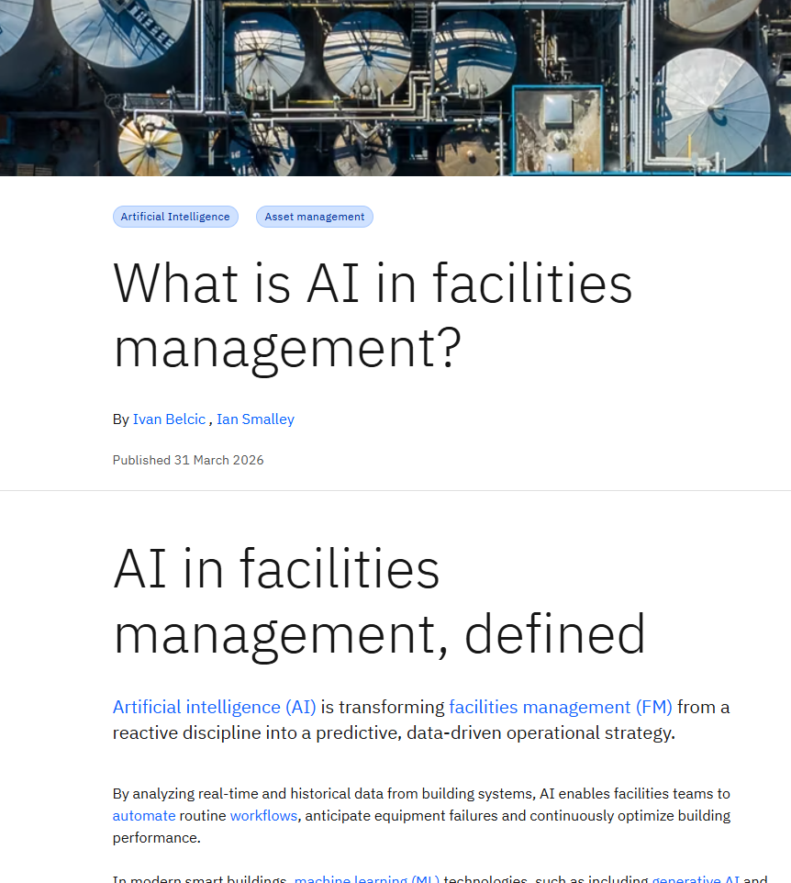
Screenshot

Slide 3
Link to the Source
https://www.ibm.com/think/topics/ai-in-facilities-management

Slide 4

Main Findings
Core findings:
AI shifts FM from reactive → predictive
Traditional FM reacts to failures or follows fixed schedules
AI uses real-time + historical data to anticipate issues before they happen
IoT + AI is the backbone of modern FM
Sensors embedded in buildings generate continuous data
AI analyzes this data to:
Predict failures
Optimize energy use
Monitor occupancy and asset performance
Key AI applications drive operational improvements
Predictive maintenance → reduces downtime
Energy management → lowers costs and emissions
Workflow automation → improves efficiency
Space utilization → optimizes building use
Digital twins → simulate and improve performance
AI enables smarter decision-making at all levels
Operational: maintenance scheduling, energy control
Strategic: capital planning, risk management, long-term investment
Clear performance benefits
Lower costs
Increased efficiency
Reduced downtime (10–20% improvement)
Longer asset lifespan
Improved sustainability outcomes
Challenges are real but manageable
High upfront costs
Data quality and integration issues
Cybersecurity risks
Organizational resistance to change
👉 Main argument: AI turns facilities management into a strategic business function that improves performance, reduces costs, and supports long-term organizational goals.

Slide 5

Broader Implications for Society
Key implications:
• Smarter, more sustainable buildings
AI continuously optimizes energy use (HVAC, lighting, etc.)
Reduces emissions and supports ESG goals
Buildings become active participants in climate strategy
• Transformation of work and skills
Routine tasks (manual inspections, scheduling) are automated
FM roles evolve toward:
Data analysis
System oversight
Strategic planning
Increases demand for digital and AI literacy
Digital infrastructure resilience
• Enhanced human experience in buildings
AI improves:
Comfort (temperature, air quality)
Safety (intelligent security systems)
Responsiveness (faster maintenance)
Particularly impactful in offices, hospitals, campuses
• Rise of “data-driven infrastructure”
Buildings become continuous data generators
Leads to:
Better decision-making
Greater transparency
But also raises concerns:
Data privacy
Cybersecurity risks
• Increased reliance on automation
Facilities operate with less human intervention
Improves efficiency but increases dependence on:
AI systems
Digital infrastructure resilience

Slide 6

Relevance and Potential Influence on the Construction Industry
1. Shift toward lifecycle-driven construction
Buildings must now be designed for:
Long-term data collection
AI integration
Moves industry from:
“Build → hand off” → “Design → operate → optimize”
2. Increased demand for smart building infrastructure
New construction must include:
IoT sensors
Connected systems (BMS, HVAC, security)
AI-ready infrastructure becomes a baseline expectation
3. Growth of digital twins and BIM integration
AI-powered FM relies on:
Digital twins
Accurate building data models
Forces tighter integration between:
Design
Construction
Operations
4. Changing project requirements and specifications
Owners will increasingly demand:
Energy-efficient, AI-optimized systems
Real-time monitoring capabilities
Integrated software ecosystems
👉 This affects:
Design decisions
Procurement strategies
Contractor responsibilities
5. Competitive advantage for forward-thinking firms
Firms that incorporate AI/FM considerations:
Deliver higher-value assets
Win more complex, tech-driven projects
Especially relevant in:
Commercial real estate
Healthcare
Smart cities
6. Convergence of construction and operations
The gap between AEC and FM is shrinking
Construction firms must think like operators
👉 AI is a key driver of this industry convergence.

Slide 7
